Slide 1
Problem solving with graphical representations of data
Graphical representations of data

Slide 2
how to use Oak lessons

Slide 3
I can use my understanding of various graphical representations to solve problems.

Slide 4
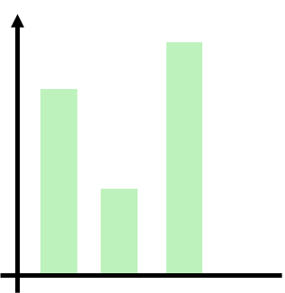
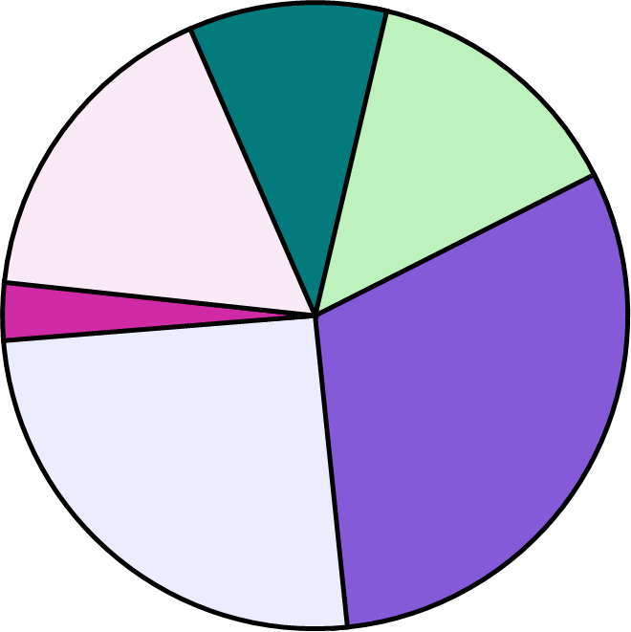
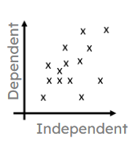
A bar chart (bar graph) is a graph consisting of bars visually representing the frequency of objects or groups.
frequency
categories
A pie chart (pie graph) is a circular graph where sectors represent different groups proportionally.
A scatter graph is a visual representation for bivariate data. It can be useful when determining the nature of the relationship between the variables.

Slide 5

Problem solving with graphical representations of data
Problems with different representations of data
Responding to additional data

Slide 6
Problems with different representations of data
Bar charts, pie charts and scatter graphs are common ways to represent data visually. However, they are not the only types of graphs.
Data can sometimes be presented using variations of these graphs or in other unusual ways.
An important skill for solving problems with data is to be able to interpret data when it is presented in novel ways.

Slide 7

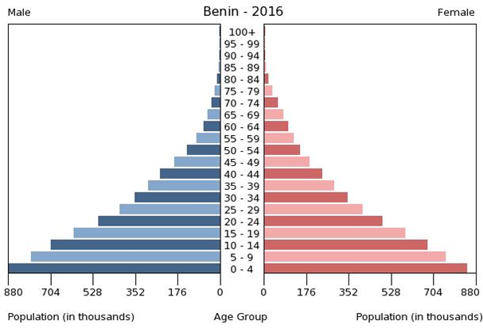

Problems with different representations of data
The graph shows data about the population of Benin in 2016.
Determine whether each of the following statements are true, based on this data.
male
female
There are more men than women.
The biggest population group is babies and toddlers.
There are not many elderly people.
The biggest population group is working-age men.

Slide 8
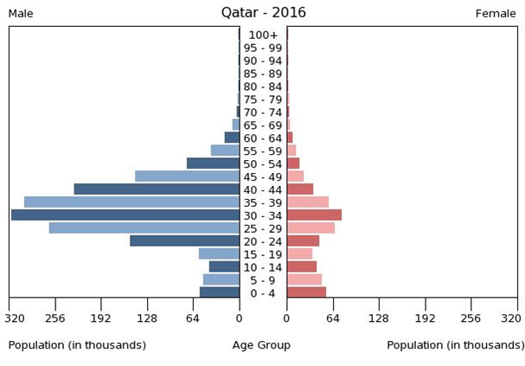
Problems with different representations of data
The graph shows data about the population of Qatar in 2016. Which statement is true about Qatar in 2016?
male
female
There were more men than women.
There were more women than men.
There were approximately the same number of men and women.

Slide 9
Problems with different representations of data
The graph shows data about the population of Qatar in 2016. Which is the biggest population group in this data?
male
female
babies and toddlers
working-age men
elderly women

Slide 10
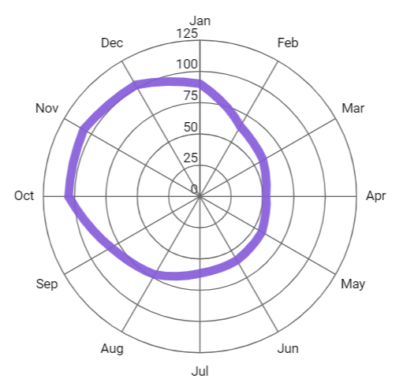
Problems with different representations of data
The graph shows data from the Met Office about the average rainfall (mm) per month in Aberporth, from 1941 to 2022.
Which month tends to be the wettest?
November
Which month tends to be the driest?
April
Which month tends to be wetter: February or August?
August

Slide 11
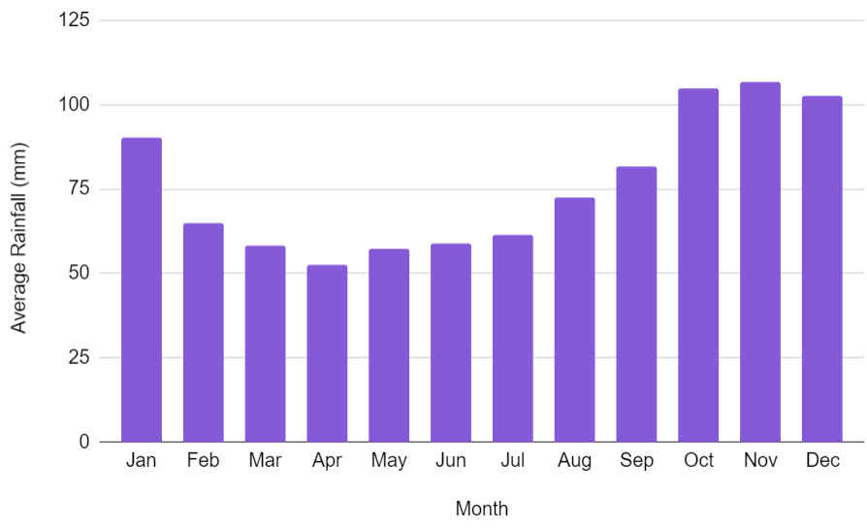
Problems with different representations of data
The same data can be displayed using multiple different representations.
Using multiple representations for the same data is not always necessary.
It may be better to choose a graph that presents what you want to see about the data in the clearest way.

Slide 12
Problems with different representations of data
What could be the advantages of using each type of chart?
Bar chart: easier to compare one month with another.
Radar chart: shows the year as a cycle, linking December with January.

Slide 13
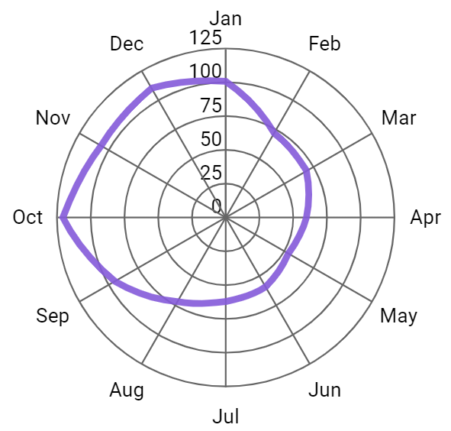
Problems with different representations of data
Based on the data below, which month tends to be the wettest?
October

Slide 14
Problems with different representations of data
Based on the data below, which month tends to be the dryest?
May

Slide 15
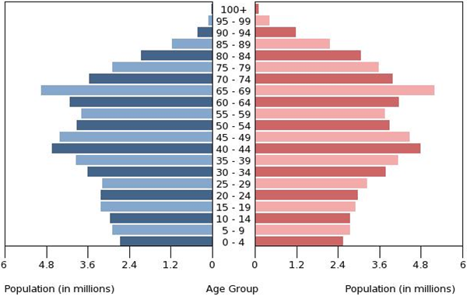
Problems with different representations of data
1) The graph shows data about the population of Japan in 2016.
Tick the statements below which are true, based on this data.
male
female
There are significantly more men than women.
The biggest population group is school-age children.
There are not many people over 90 years old.
The number of babies born has gone down over time.

Slide 16
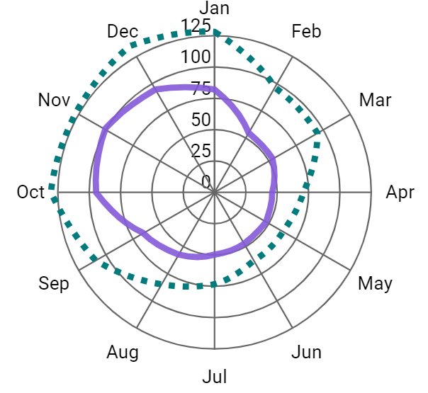
Problems with different representations of data
2) The graph shows data from the Met Office about the average rainfall (mm) per month in two towns, from 1941 to 2022.
a) Which town tends to get more rainfall?
b) Which town tends to have its wettest month of the year in November?
c) Which tends to be wetter: February in Eastbourne or July in Stornoway?
Eastbourne
Stornoway

Slide 17
Problems with different representations of data
1) The graph shows data about the population of Japan in 2016.
Tick the statements below which are true, based on this data.
male
female
There are significantly more men than women.
The biggest population group is school-age children.
There are not many people over 90 years old.
The number of babies born has gone down over time.

Slide 18
Problems with different representations of data
2) The graph shows data from the Met Office about the average rainfall (mm) per month in two towns, from 1941 to 2022.
a) Which town tends to get more rainfall?
b) Which town tends to have its wettest month of the year in November?
c) Which tends to be wetter: Eastbourne in February or Stornoway in July?
Stornoway
Eastbourne
Stornoway in July
Eastbourne
Stornoway

Slide 19
Problem solving with graphical representations of data
Problems with different representations of data
Responding to additional data

Slide 20

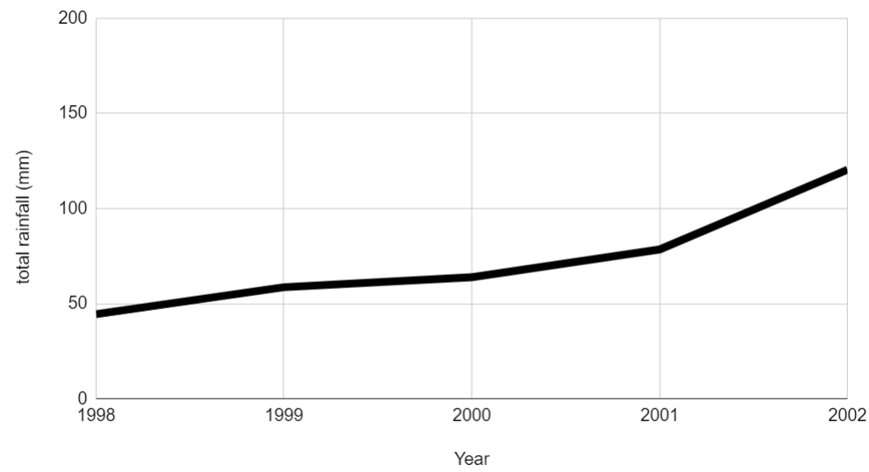
Responding to additional data
Jacob claims that summers tend to be getting wetter every year.
He presents rainfall data for each August in Bradford from 1998 to 2002.
The graph appears to support his claim.
Why might this data not fully support his claim?
The graph only shows five years of data.
How could he be more sure about his claim?
Collect more data.

Slide 21
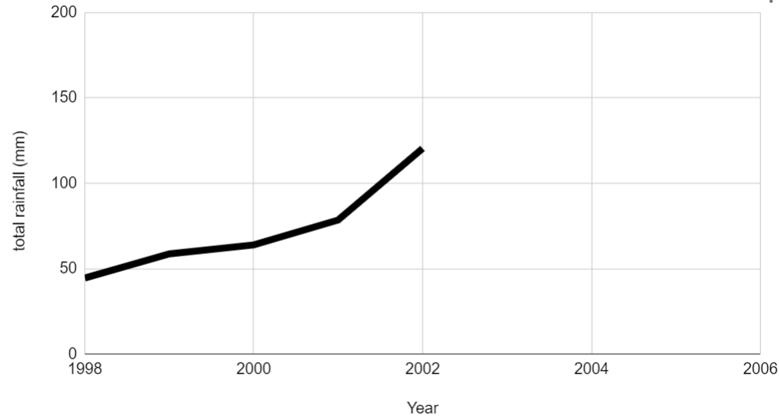
Responding to additional data
Jacob investigates his claim further by collecting rainfall data for the next four years.
Plot these new points on the graph.
year | total rainfall in August (mm)
2003 | 9.6
2004 | 189.9
2005 | 47.5
2006 | 92.7

Slide 22
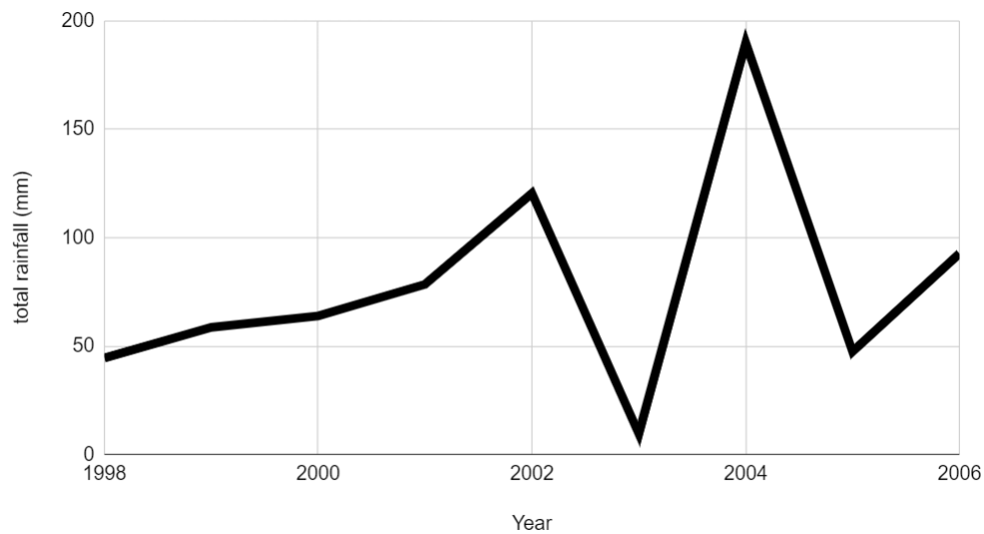
Responding to additional data
Jacob investigates his claim further by collecting rainfall data for the next four years.
How might this additional data affect Jacob’s claim that summers are getting wetter every year?
It shows that the amount of rainfall in August has increased and decreased between 1998 and 2006, meaning that it has not gotten wetter every year.

Slide 23
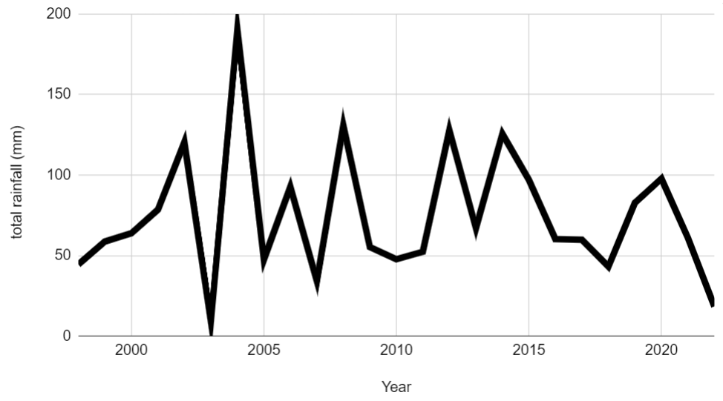
Responding to additional data
He presents rainfall data for each August in Bradford from 1998 to 2022.
There are some consecutive years where the amount of rainfall increased each year.
But there are are also some consecutive years where the amount of rainfall decreased each year.
Only looking at small amounts of data can create false impressions.

Slide 24
Responding to additional data
A small amount of data is enough to be certain about a claim.
The data is enough to show that the claim is definitely correct.
Including more data might give a different impression.

Slide 25

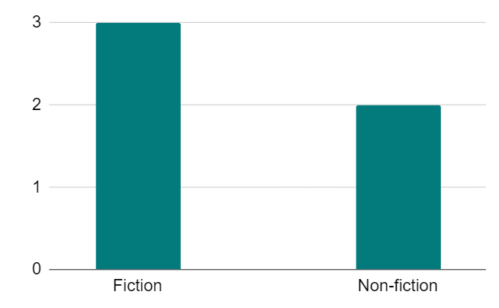
Responding to additional data
Sam investigates which genre of book is more popular: fiction or nonfiction.
Sam asks five people whether they prefer reading fiction or nonfiction and then presents the data in a bar chart.
Sam concludes that fiction is a more popular genre than nonfiction.
What could Sam do to be more confident about their conclusion?
Ask more people.
Collect a greater amount of data for the bar chart.

Slide 26
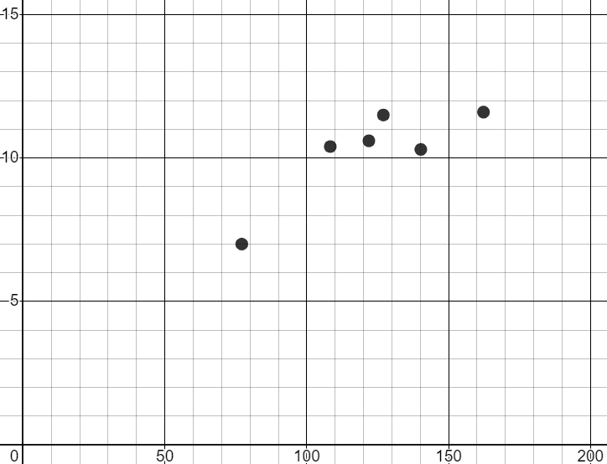
Responding to additional data
1) Sofia investigates whether there is a connection between sunshine and temperature. She collects weather data in Bradford for each March from 2017 to 2022 and plots a scatter graph. She concludes that there is no connection between the variables.
a) The table shows data from 2012 to 2016. Plot the points on the scatter graph.
sunshine (hours) | 162 | 67 | 124 | 105 | 106
temperature (℃) | 13 | 4 | 11 | 9.5 | 9
mean of daily maximum temperature (℃)
b) How might these additional points affect Sofia’s conclusion?
total sunshine duration (hours)

Slide 27
Responding to additional data
1) Sofia investigates whether there is a connection between sunshine and temperature. She collects weather data in Bradford for each March from 2017 to 2022 and plots a scatter graph. She concludes that there is no connection between the variables.
a) The table shows data from 2012 to 2016. Plot the points on the scatter graph.
sunshine (hours) | 162 | 67 | 124 | 105 | 106
temperature (℃) | 13 | 4 | 11 | 9.5 | 9
mean of daily maximum temperature (℃)
total sunshine duration (hours)

Slide 28
Responding to additional data
b) How might these additional points affect Sofia’s conclusion?
It looks more likely that there could be a connection between the variables.
mean of daily maximum temperature (℃)
Months with more sunshine tend to have higher temperatures.
total sunshine duration (hours)
More data could it make even clearer whether there is a connection.

Slide 29
Problem solving with graphical representations of data
Data can be presented in various formats.
Multiple representations may be unnecessary.
A fuller picture can be obtained when considering more data.

Slide 30

© Oak National Academy 2023.
Produced in partnership with Mathematics in Education and Industry.
Licensed on the Open Government Licence v3.0, except where otherwise stated. See Oak terms and conditions.

